Slide 1

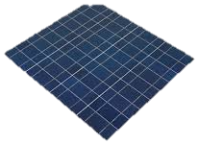
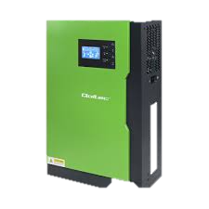
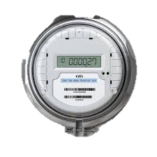
A Novel Evaluation Framework for Selecting the Best Solar Farm Locations:
A Case Study of Lithuania and Poland

Slide 2
Content
Project Description
Data Criteria
Workflow

Slide 3
Project Details
 | Description
Project Name | A novel Evaluation Framework for selecting the best solar farm location: a case study of Lithuania and Poland
Project Duration | 36 months
Project Leader | Dr inz Vishnu Suresh
Keywords | Photovoltaic farms; Low-carbon energy transition; Solar energy; Renewable energy; Site selection.
Funding Budget | 484 791 zł

Slide 4
Project
Element
Problem
Solution
Objective
The selection of a solar farm location depends on many factors, creating a complex decision-making problem for the investor. Distribution system operators (DSOs) also face similar challenges when expanding infrastructure.
The integration of GIS-based MCDM analysis with machine learning enables precise, efficient, and scalable selection of solar farm locations for investors, enhances infrastructure expansion planning for distribution system operators (DSOs), and supports improved spatial planning for local authorities.
The project aims to advance solar energy development by creating a framework of key criteria for site selection.
The developed framework supports decision-makers and investors in the energy sector in building photovoltaic farms in Poland and Lithuania.

Slide 5





01
Technical Benefits
Grid planning
Reduced grid congestion risk
02
03
Investment Benefit
Environmental/Social
Investment Planning
Risk Reduction
Capital Efficiency
Improved ROI
3
OFFERS
Carbon Reduction
Clean Energy Transition
Public Acceptance
Efficient Land Use

Slide 6

INNOVATIVE
Framework
MCDM
ML/DL
Geographic Information Systems
Multi-Criteria Decision Making
Machine/Deep Learning
The project aims to identify optimal sites for constructing solar farms in Poland and Lithuania to maximize photovoltaic energy output and support sustainable energy practices.
Acquire and preprocess spatial data using GIS.
Develop and MCDM model in a fuzzy decision-making context
Develop machine/deep learning model for comparative analysis

Slide 7


Project
Partner
Lithuania
Poland

Slide 8

Poland
Side
Specific research task
Developing a Framework Criteria
Finding Required Data
Developing MCDM Models
Integrate and Implement Proposed Model
Planning Scenarios and Policies
Project Team
Vishnu Suresh
Przemysław Janik
Dominika Kaczorowska
Fachrizal Aksan
Poland
Expected Effects
Project Duration
Higher Energy Output
Cost Efficiency
Environmental Benefit
Regulatory Compliance
Strategic Planning
2025
2026
2027

Slide 9
Lithuania
Side
Specific research task
Developing a Framework Criteria
Data Acquisition and Preprocessing
Identification of the best fuzzy extension
Develop machine learning model and real world validation
Planning Scenarios and Policies
Project Team
Dalia Streimikiene
Mahyar Saraji
Mariam kasradze
Lithuania
Expected Effects
Project Duration
Higher Energy Output
Cost Efficiency
Environmental Benefit
Regulatory Compliance
Strategic Plannig
2025
2026
2027

Slide 10

Data Criteria for MCDM
Data Climate :
Solar radiation + Temperature
Data Topographic:
Elevation + Contour Line + Land Use
Data Power Infrastructure:
Power Line + Substation + PV Farm
Data Infrastructure:
Road + Highway/Railways
1st Study Case
Dolnośląskie
Data Policy:
Regulation + Law

Slide 11
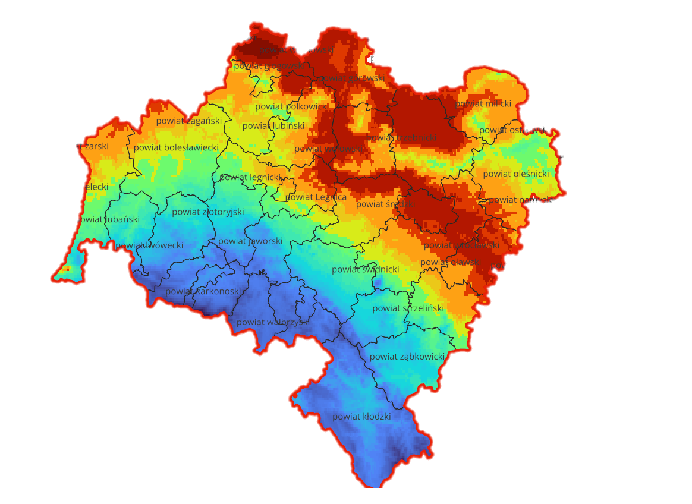
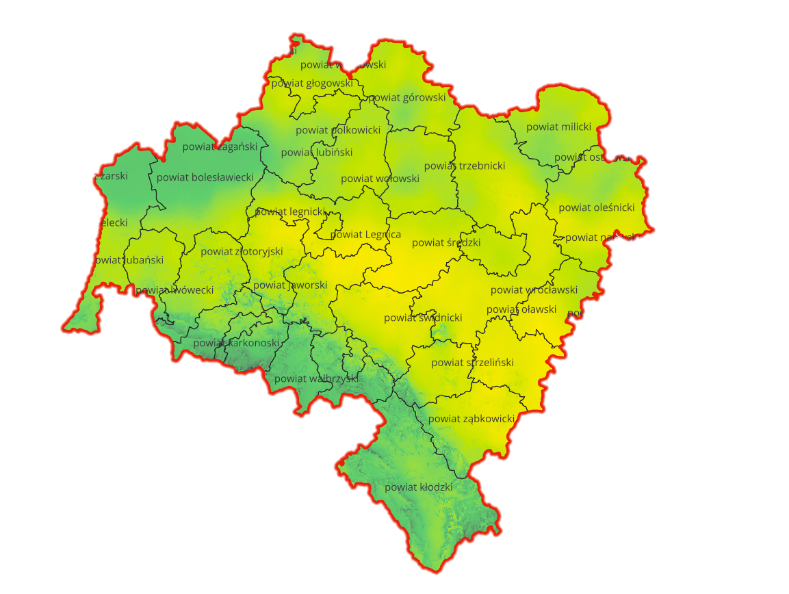
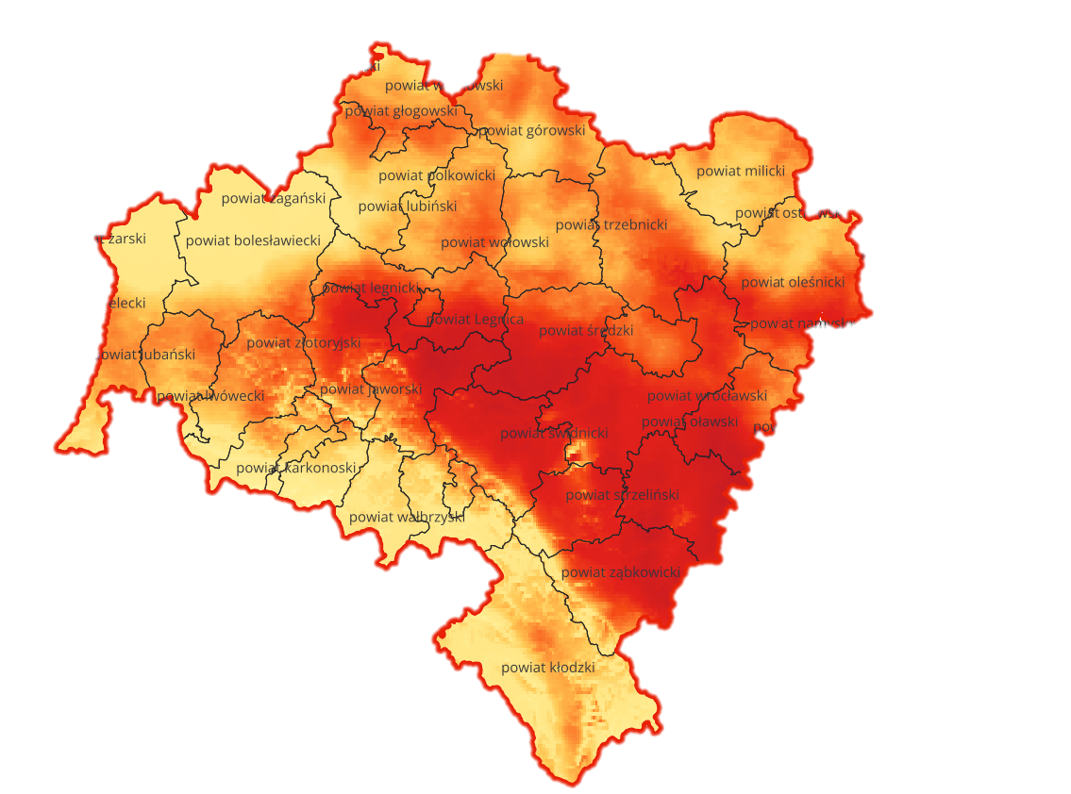
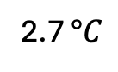
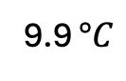
Data Criteria
Climate
Topography
Power
Infrastructure
Temperature
Direct Normal Irradiance
(DNI)
Potential Photovoltaic
Electricity Generation
9.9 $°C$
1039 kWh/m²
1134 kWh/kWp
2.7 $°C$
703 kWh/m²
856 kWh/kWp

Slide 12
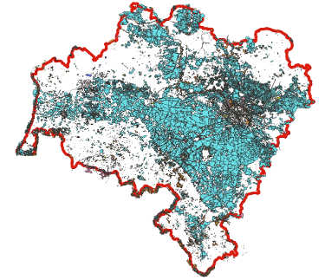
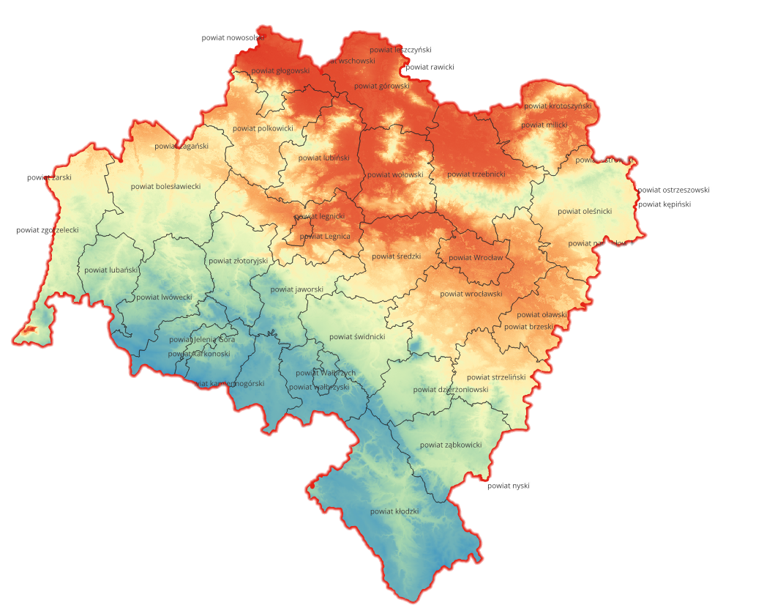
Data Criteria
Climate
Topography
Power
Infrastructure
Land Use
Elevation
Type of Land Considered
Farmland
Farmyard
Grass
Heath
Meadow
Scrub
>= 2 Ha
1520 meters
40 meters

Slide 13
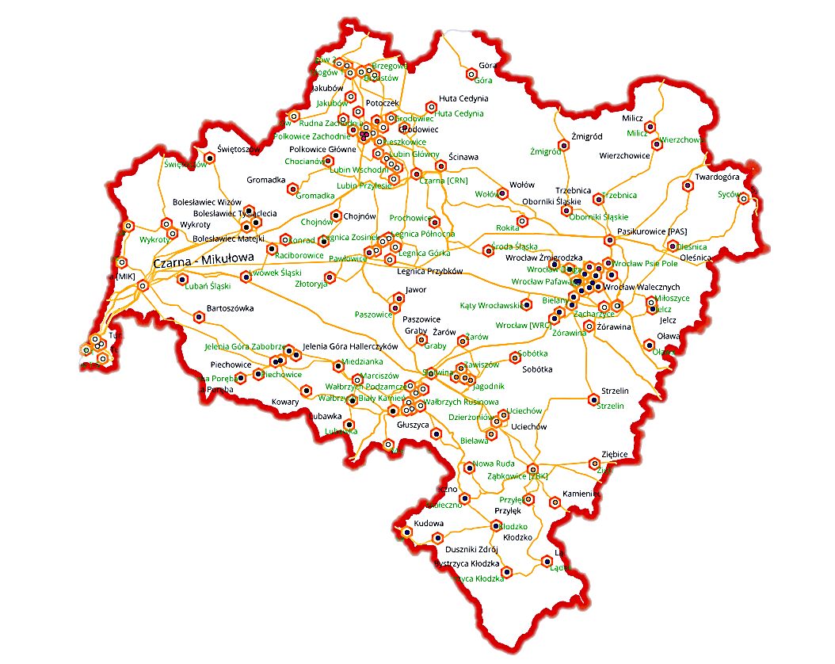
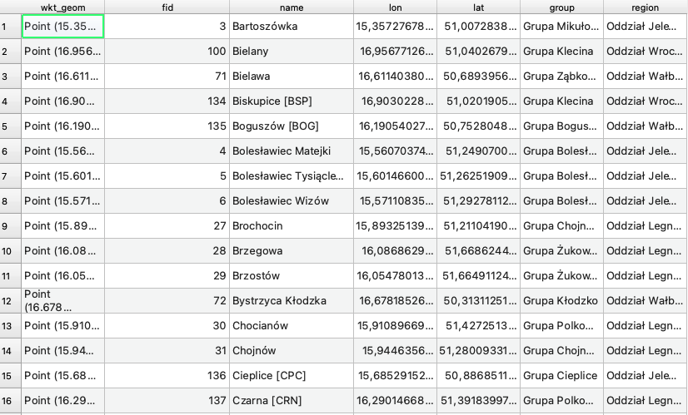
Data Criteria
Climate
Topography
Power
Infrastructure
Parameter inside:
Latitude
Longitude
Substation’s name
Substation’s group
Substation’s region
Power Line’s Name
Solar Farm location
Wind Farm Location
Area Size

Slide 14
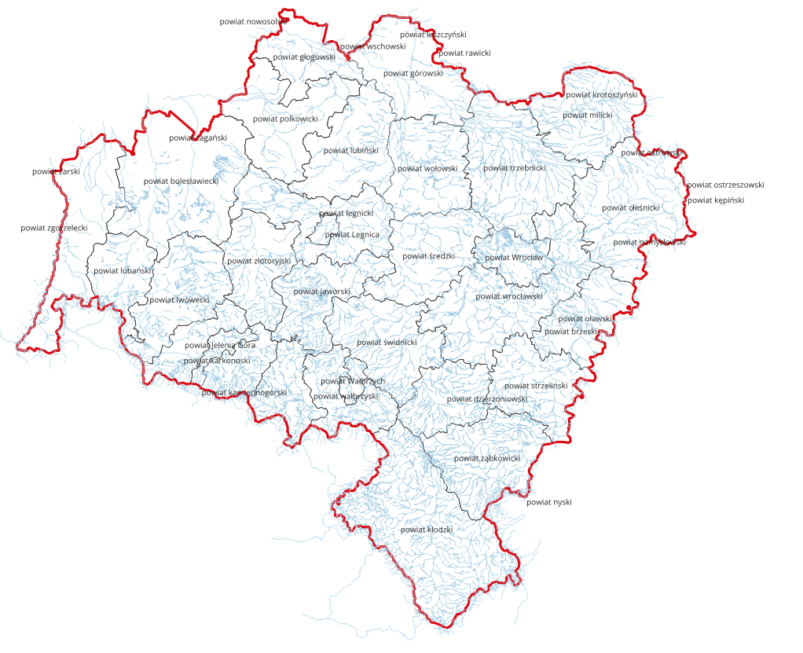
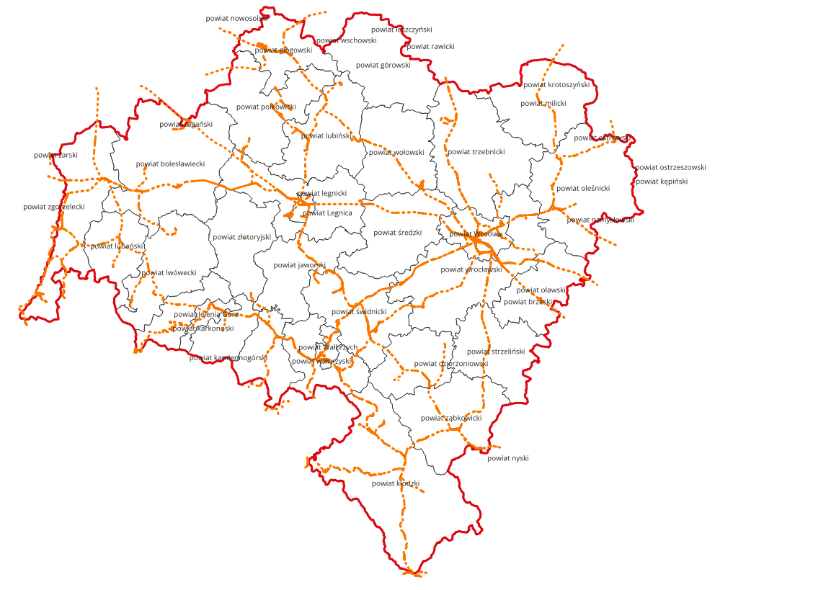
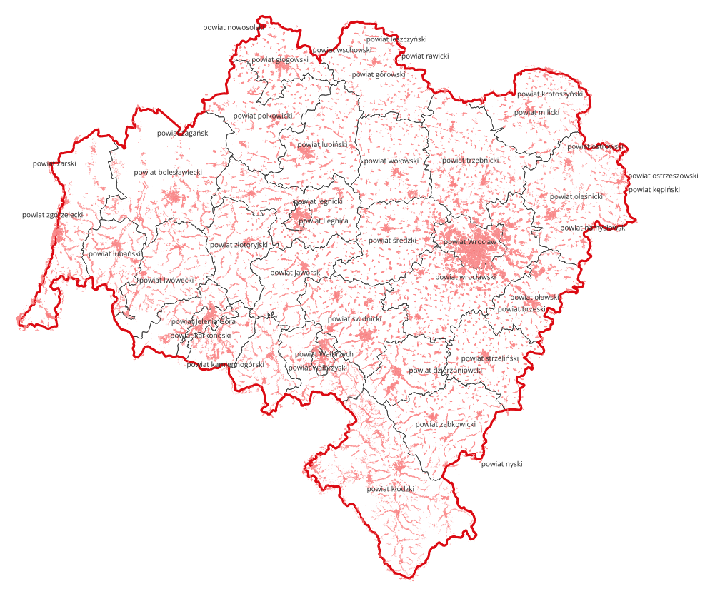
Data Criteria
Climate
Topography
Power
Infrastructure
Water Ways
Railway/Road Network
Building
Flood risk / Waterlogging issues
Water supply
Transport of materials
Access for workforce and maintenance
Availability of construction facilities
Storage and security

Slide 15
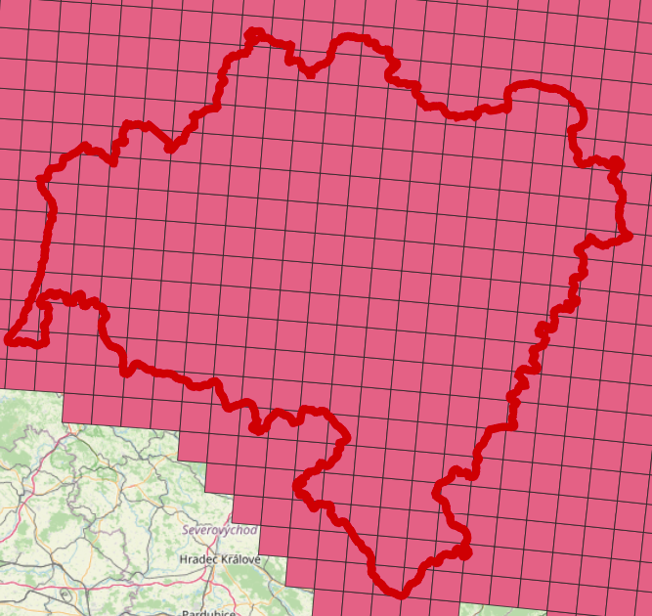
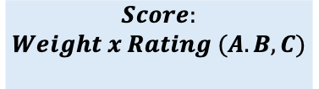
Workflow
MCDM
ML/DL
Tools
Key Steps of MCDM
Define Objective
Define Criteria
Weight of Criteria
List the Option
Rate the Option
Calculate Score
Select highest score
Criteria
Weight
A
B
C
$$Score:$$
$$Weight x Rating (A.B,C)$$
Topography
60 %
Low
Medium
High
Climate
40 %
Medium
Medium
Medium
Power
70 %
Low
High
High
Grid area < 10 km
Infrastructure
55 %
High
Medium
Low
Policy
50 %
Low
Medium
High

Slide 16
Workflow
MCDM
ML/DL
Tools
Data
Testing
Prediction
Data
Preparation
Data
Algorithm
Evaluation
Model
Data
Training
Criteria

Slide 17
Workflow
MCDM
ML/DL
Tools
Data Source
MCDM Analysis
ML/DL Analysis
NASA
Copernicus
Earth Data
Open Street Map
QGIS
Pyqgis
Microsoft Excel
Google Earth
Keras Library
Scikit Learn
Visual Studio Code
TensorFlow

Slide 18
Power Capacity
Power Consumption & Power Production
Potential Data
Request
Storage Capacity
Waiting List for Substation

Slide 19
THANK YOU

